Slide 1
chapter 7
Descriptive Statistics
Frequency & Contingency Tables
Instructor: Huang, Jia-Ping

Slide 2
Contents
Descriptive statistics
Tables

Slide 3
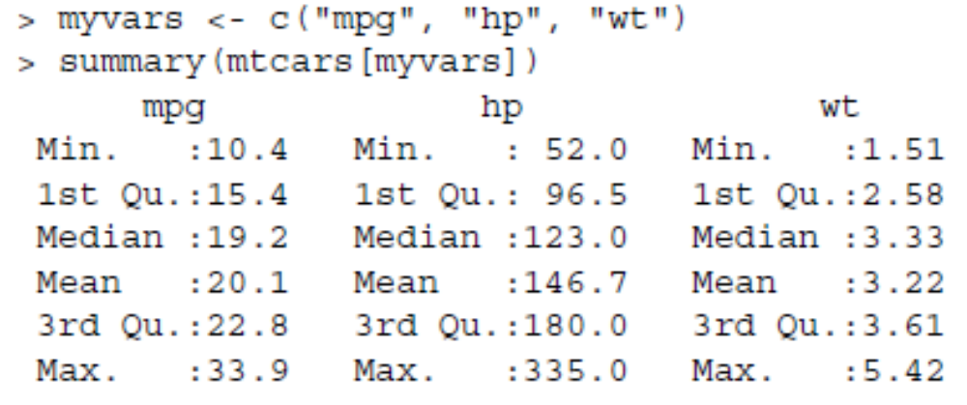
Descriptive statistics
The summary() function

Slide 4
Descriptive statistics
The summary() does not provide enough information to understand a sample of data.
Use a combination of sapply() and functions like mean(), sd(), var(), min(), max(), median(), length(), range(), quantile(), etc., to produce the statistics you need.

Slide 5
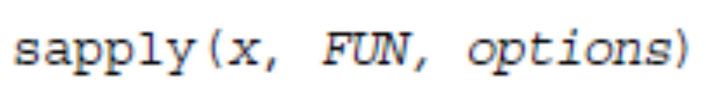
sapply()
apply() applies a function over the margins of an array
sapply() applies a function over a list or vector.

Slide 6
> mydata <- data.frame(x = rnorm(20, 2, 1), y = rnorm(20, 3, 2))
> apply(mydata, 2, sd)
x y
0.9729847 1.6987539
> sapply(mydata, sd)
x y
0.9729847 1.6987539

Slide 7
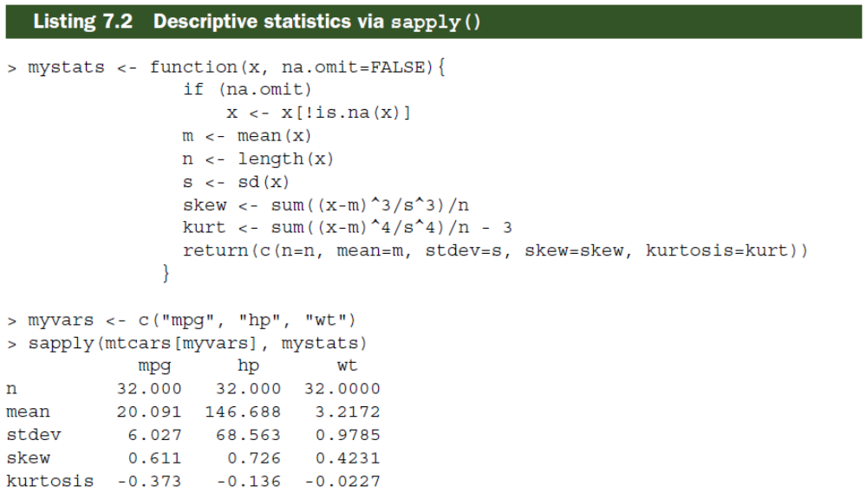

Slide 8
Other useful functions
describe() in the Hmics package
stat.desc() in the pastecs package
describe() in the psych package

Slide 9
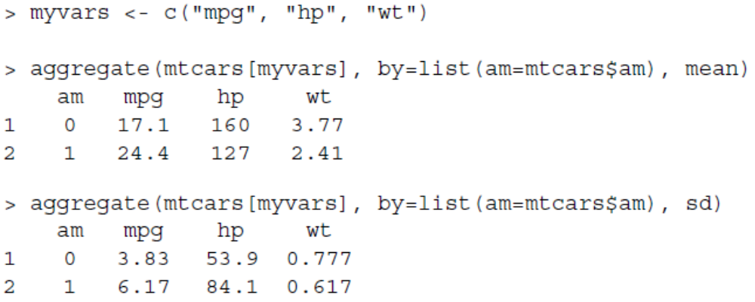
The aggregate() function
We can divide our data set into groups and produce descriptive statistics for each group.
This can be done by using the aggregate() function.

Slide 10
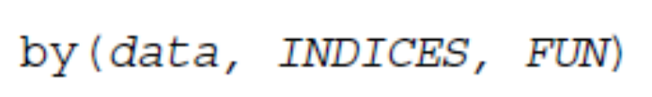
The by() function
aggregate() only allows you to use single-value functions such as mean().
With by(), you can return several statistics at once.

Slide 11
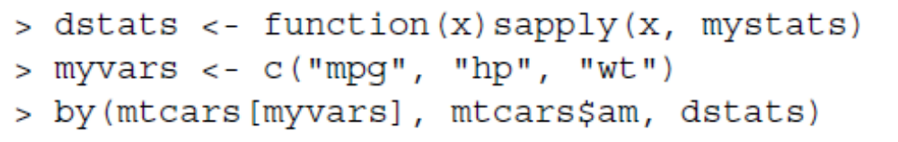
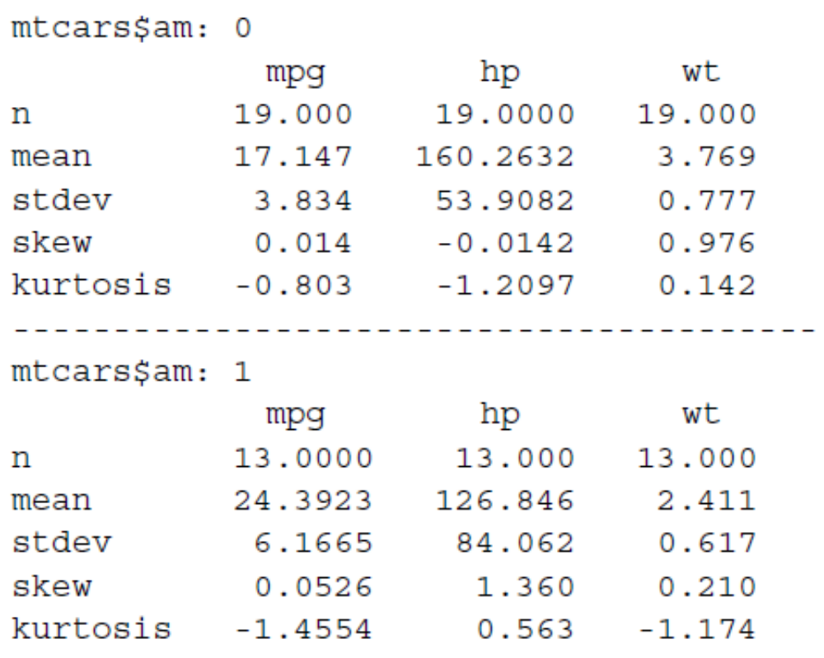

Slide 12
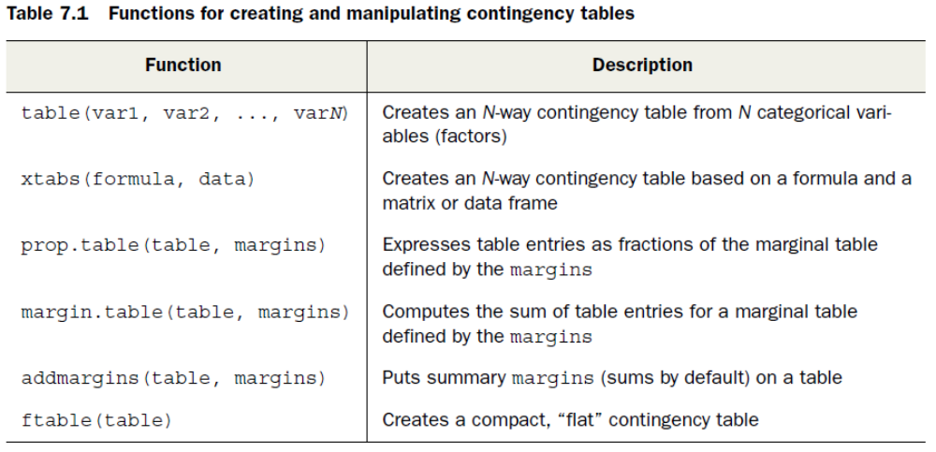
Tables
R provides several methods for creating frequency and contingency tables.

Slide 13

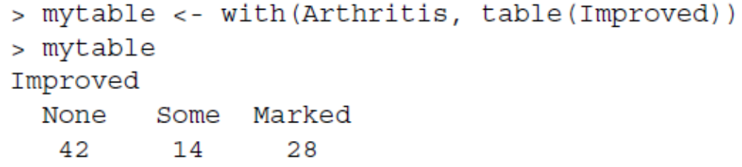
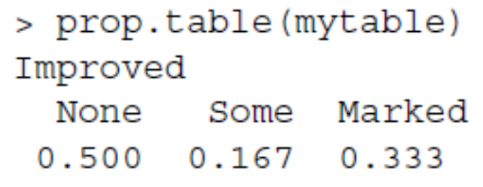
One-way tables
table()
prop.table()

Slide 14

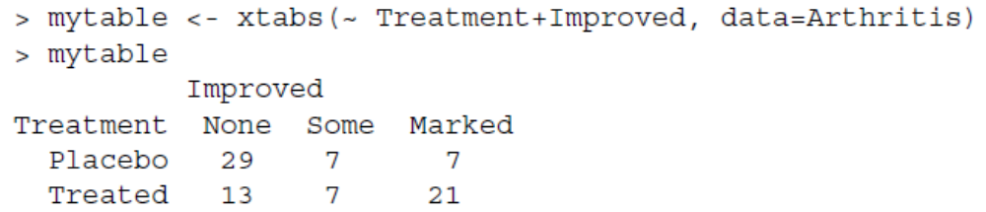
Two-way tables

Slide 15
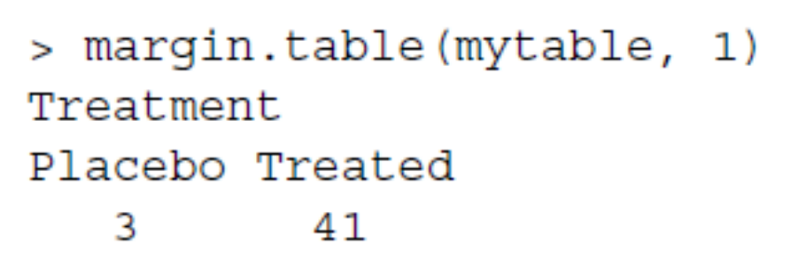
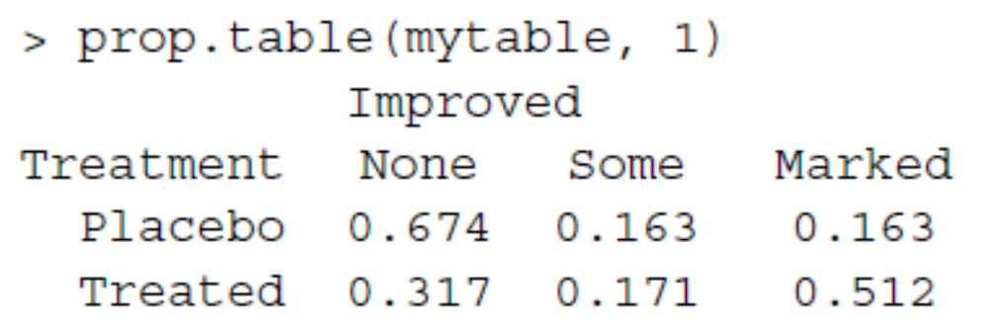
Take row/column sums
The index 1 refers to the first
variable in the table() statement.

Slide 16
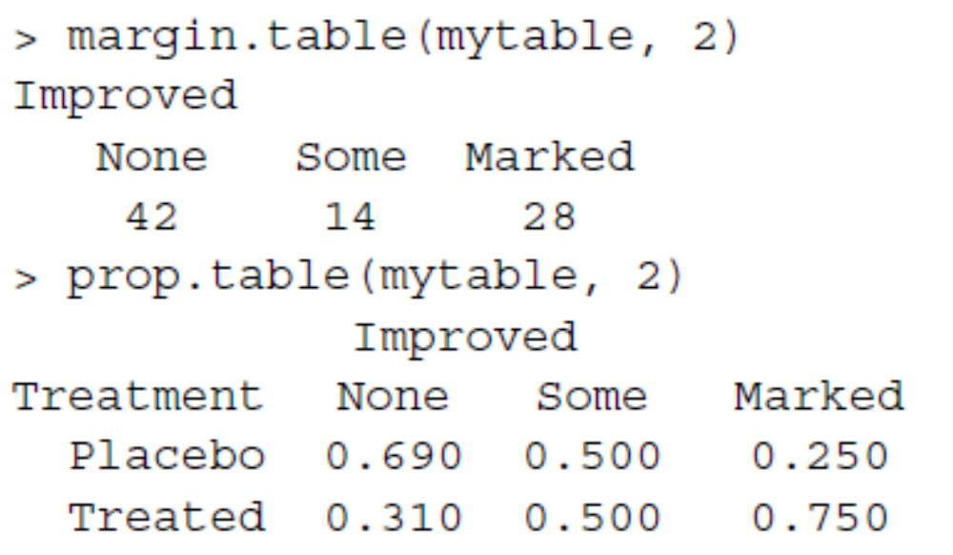
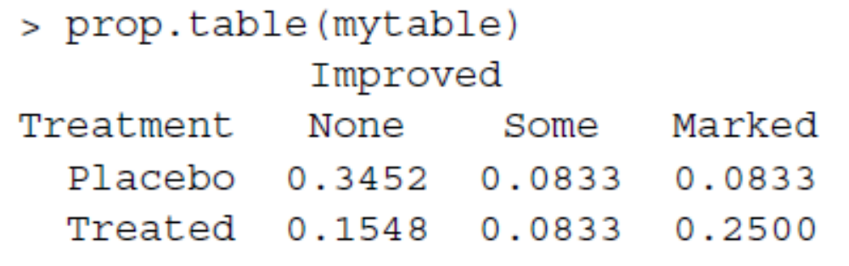
Proportions of the overall sum

Slide 17
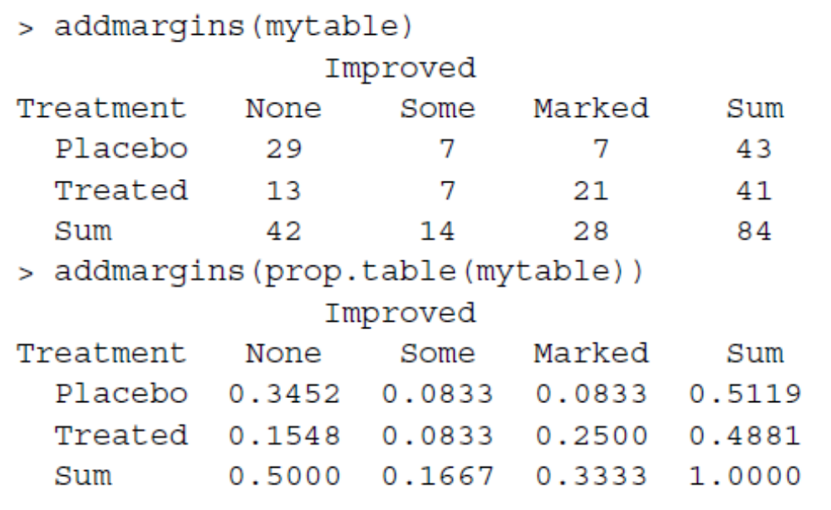
Add marginal sums

Slide 18
Summary
Descriptive statistics is the first step of statistical analysis.
Creating frequency/contingency tables is a useful way of data visualization.
Important functions:
summary(), sapply(), aggregate(), by(), table(), prop.table()

